Slide 1
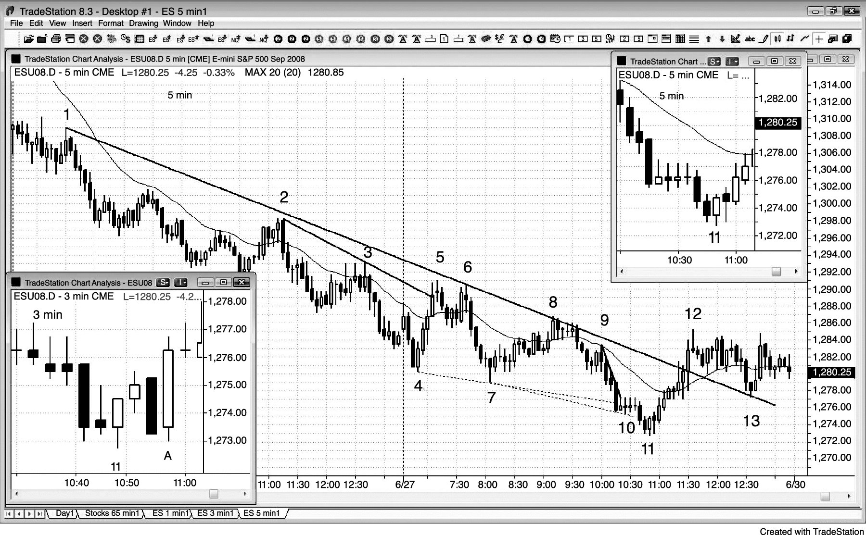
FIGURE 8.1 Smaller Time Frame Charts Result in More Losses

